Slide 1
Implementation Integrierter Systeme für Microsoft Azure Stack
Robert Mader
www.expertslive.at https://www.hpe.com/at/de/solutions/cloud/azure-hybrid-cloud.html

Slide 2

Ing. Robert Mader
Solution Architekt und Technical Consultant
Hewlett Packard Enterprise
Österreich

Slide 3
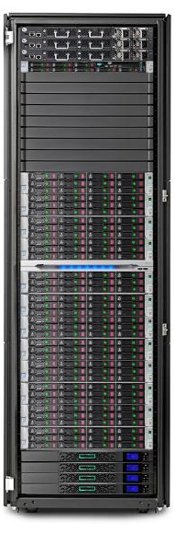
HPE ProLiant for Microsoft Azure Stack Solution
An on premise instance of Azure Stack and portal to Azure Cloud
Region 1
Single instance of Azure Resource Manager (ARM)
1 or more Regions under management of ARM
Minimum of 4 or more servers within a Scale Unit. Initial configuration can be anywhere between 4 and 12.
1 or more Scale Units (SU) within a region
At release, Microsoft will support only 1 Region with max 12 nodes
Additionally, Microsoft will also not support “in-scale-unit expansion”.
Advice is to purchase solution sufficient to meet workload and growth requirements for first 8-12 months.
Scale Unit 1
Min of 4 nodes
Max of 12 nodes

Slide 4
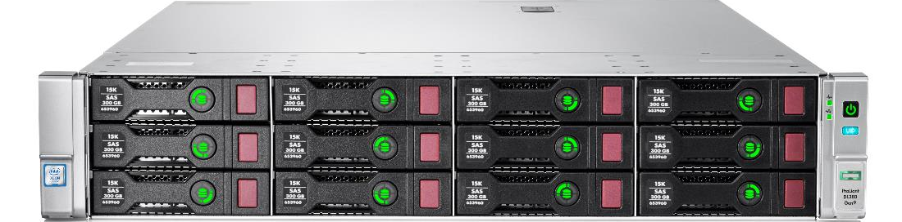

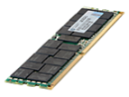
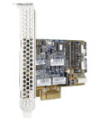
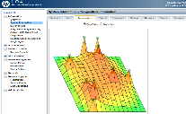

Based on Proven HPE ProLiant infrastructure
HPE Sells a DL380
Every 20-30 seconds!
Platform for multiple
solutions such as
HC380 and
Simplivity on HC380
What makes the difference …
Active Health System
Smart Memory
Smart Array
Smart SSD & SAS Drives
3D Sea of Sensors

Slide 5
Configurable to meet your workload requirements
Highly configurable—Processor, memory, storage, single-node sizing, and rack/virtual rack
Entry configuration:
4 HPE ProLiant DL380 Servers, 76 VMs
Dual 2.2 GHz processor, 24 cores/server
256 GB memory/server
Largest configuration - > 150% VM capacity of competing systems:
12 HPE ProLiant DL380 Servers, 1704 VMs
Dual 2.2 GHz processor, 44 cores/server
768 GB memory/server
Hardware configuration options
Intel Xeon CPUs
CPU | GHz | Cores
E5-2699v4 | 2.2 | 22
E5-2698v4 | 2.2 | 20
E5-2695v4 | 2.1 | 18
E5-2683v4 | 2.1 | 16
E5-2660v4 | 2.0 | 14
E5-2650v4 | 2.2 | 12
Recommended configurations (more available)
Memory
GB | Modules
256 | 8 x 32 GB
512 | 16 x 32 GB
768 | 24 x 32 GB
 | Mem | Processor | Storage | Azure D1 VMs*
4 | 512 | E5-2683V4 | 10 x 6 TB HDD + 4 x 1.92 TB SSD | 256
8 | 512 | E5-2683V4 | 10 x 6 TB HDD + 4 x 1.92TB SSD | 760
12 | 768 | E5-2699V4 | 10 x 6 TB HDD + 4 x 1.92 TB SSD | 1704
*Azure D1 VM: 1 vCore, 3.5GB, 50GB Disk

Slide 6
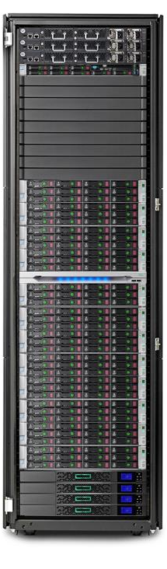
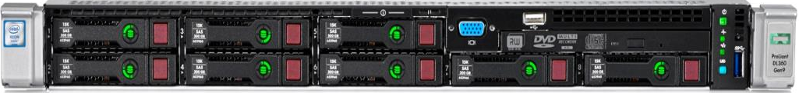
Hardware Lifecycle Host Management Server (HLH)
Monitor and maintain the solution hardware with first-class tools
1 DL360 Management node
8 SFF drive model
4 drives used.
HPE ProLiant DL360 Gen9 Hardware Lifecycle Host - OOB Management
HPE OneView – Infrastructure automation engine
HPE Stack Management Software: – HPE OneView and IRS
Increases reliability - template based management
Simplifies lifecycle management tasks
Consolidated management and monitoring of solution HW
HPE Insight Remote Support
Automatic service request submission for detected issues
24x7 real-time hardware event monitoring
Secure Internet event submission

Slide 7
Factory integration with onsite installation
Increases quality, reliability and time to value of HPE ProLiant for Microsoft Azure Stack
Factory Integration
Onsite installation
Onsite integration
Build configuration
Rack, stack and cable
Configure network switches
Install FW and HPE SW
Validate configuration
Unpack and install rack
Installation startup
System health validation
Integrated onsite network
Install Azure Stack software
Configure monitoring and supported integrations
Knowledge transfer

Slide 8
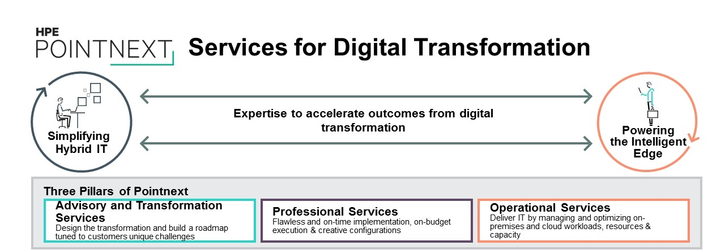

Slide 9
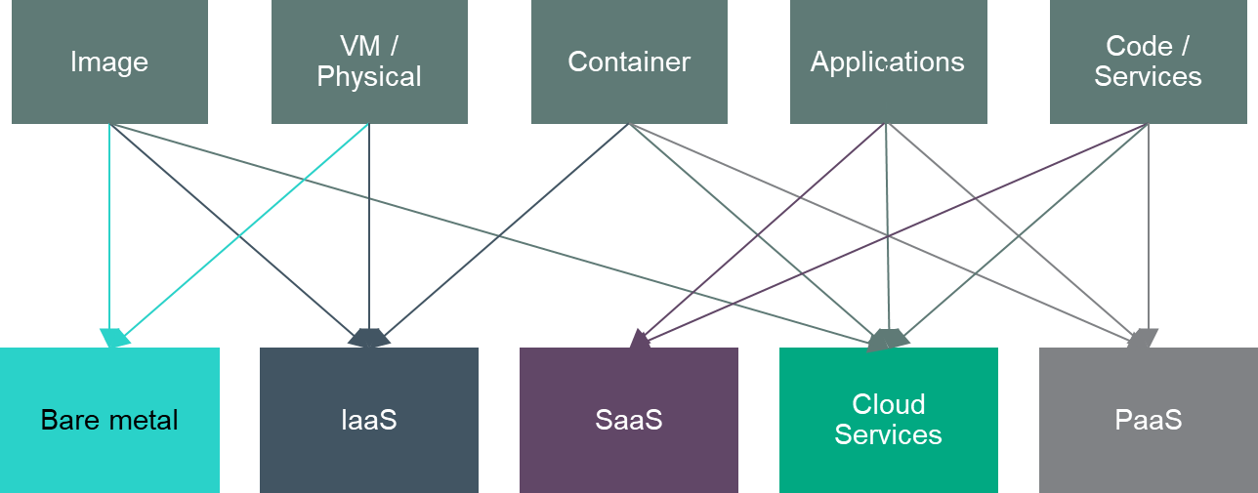
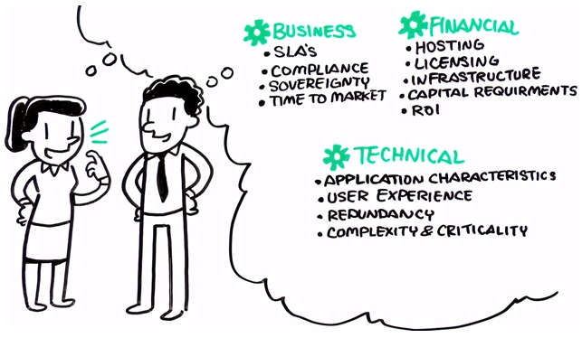
Application Suitability and Rationalization
HPE Workload Portability Services
Cloud Migration Assessment
Identify suitable workloads for migration
Prioritize workloads for migration based on feasibility, complexity and business requirements
Map workloads to established cloud platforms
Map workloads to services offered by the cloud platform
Establish tools and processes for migration
Cloud Migration Design
Plan and design workloads for migration to cloud
Private Cloud Application Design
Hybrid Cloud Workload Design
Public Cloud Workload Design
www.youtube.com/watch?v=pNQR15PYI1Y

Slide 10
Microsoft Azure Stack Workshop & POC
POC Engagement Objectives
Planning
Plan the implementation, management and monitoring of Microsoft Azure Stack
Help determine and document the defined Business & IT Goals (through collaborative workshop led discussions)
Lead a technical workshop on Microsoft Azure Stack
Plan, prioritize, and document the defined hybrid use case scenarios (through collaborative workshop led discussions)
Build
If used with single-node ASDK, install and configure Microsoft Azure Stack
Configure
Create custom images (Windows 2016 and Red Hat Enterprise Linux)
Create plans, offers and subscriptions
Set up Health Monitoring Integration
Use Cases
Implement customer defined or example HPE defined use cases e.g. LoB App, DBaaS, SQL IaaS, Multi-tier PaaS, Dev/Test
Project Close
Dedicated knowledge transfer and project close
Duration: ~3 – 6+ weeks

Slide 11
Integrate Azure in to your Hybrid IT
Consulting services with HPE experts for your specific needs
Workload Migration
Single Sign-On
Resource and Service Monitoring
Business Continuity
Network Integration
Backup and Disaster Recovery
…..and other Operational Services….

Slide 12

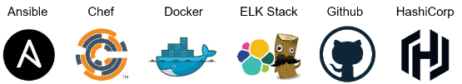
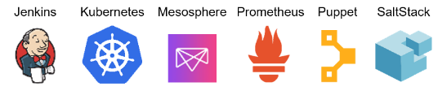
Azure related consulting
Cloud Consulting (advisory, roadmap, design, security). Support. Education. Financing
Private
Hybrid
Public
Private Cloud implementation
Windows Azure Pack
Microsoft Azure Stack
Modernize enterprise application foundation
Windows Server 2016
System Center 2016
SQL
SAP
Platform modernization
Data center transformation and automation
Hybrid protection
Azure BCDR
Cloud Protection
Hybrid platform
SQL modernization
SAP modernization
Move workloads to hybrid cloud
Workload Portability
Hybrid Infrastructure
Hybrid Identity
Hybrid Network
Azure IaaS
Hybrid Management with OMS
Hybrid Security with OMS
Broker & manage single and multiple clouds
Broker Consulting
Big Data and analytics
Big Data on Azure
Develop and deploy cloud native apps
Cloud Native Apps
VDI & Application Virtualization
Citrix on Azure
Mobility
Office365
Management of Change (MoC)

Slide 13

Flexible Capacity for Microsoft Azure Stack
Lower cost, elastic capacity, enterprise support, for hybrid IT
Pay only for what you use¹
Aligns costs with usage monthly via advanced metering
No upfront payment requirements
Save the costs of overprovisioning
Infrastructure capacity that never runs out
Scalable – add capacity in minutes, not months (subject to Microsoft limitations with Azure Stack initially)
Avoid long procurement cycles
Manage capacity jointly with account team
Applies to servers, software-defined and traditional storage, networks, converged, and software
HPE and multivendor support
Hybrid-ready with certain Microsoft Azure services
Add Azure Stack solution to existing Flexible Capacity contract²
Increase Capacity
Requested capacity
Pay only for
what you use¹
Local
Buffer
Decrease Capacity
Business application
Flexible Capacity customer reducing TCO by 30% by eliminating over-provisioning
Subject to a minimum commitment for hardware and software
Contact your HPE Technical Services rep for more details

Slide 14
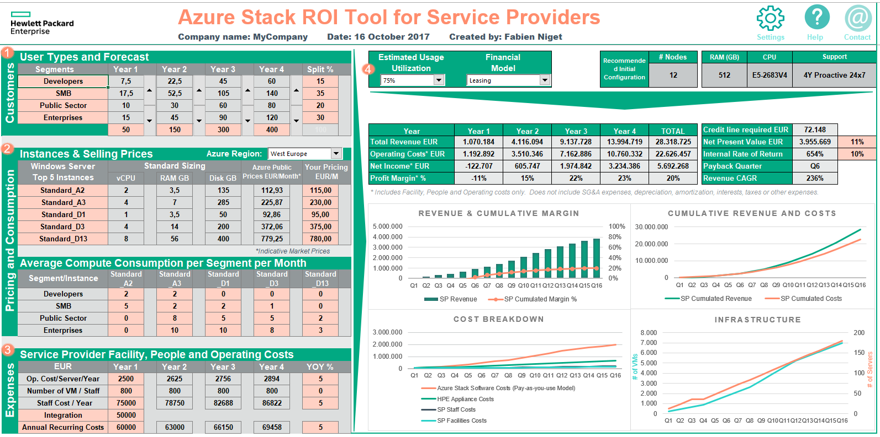
HPE-Advantage - Azure Stack ROI Tool for Service Providers

Slide 15

Integrated system support
Proactive care bundled with HPE ProLiant for Microsoft Azure Stack
Prevent problems before they occur
Tailored reports, expert reviews and recommendations for:
Proactive System scans
Firmware/patch analysis
Incident/Trend analysis
Support with Microsoft
Solve problems faster
24x7 monitoring
Pre-failure alerts
Fast, accurate problem detection
Automated call logging parts dispatch
Enhanced call handling – start to finish case management
Call
management
Customer
Stay informed and in control
Personalized dashboard
Global knowledgebase
Community of Experts (HPE, partners, peers)
HPE is Cloud Solution Provider (CSP)!

Slide 16
HPE monitoring and management
HPE Data Center Care – Operation Support Services
On-premises – Azure Stack
Off-premises – Azure
Remote monitoring and management for heterogeneous IT
Out-tasking of routine work for IT operations
Frees up IT resources for more productive work
Manage Azure services—for example: use VM management to provision, delete, resize, monitor, and troubleshoot VMs in Azure
Governance integrated with your account support team
One
One partner for operations and support
One integrated relationship
One governance and process framework
One management tool box
experience

Slide 17
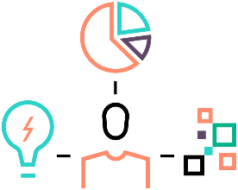





Joint HPE-Microsoft Innovation Centers – Bellevue & Geneva
Come meet HPE and Microsoft Azure Stack experts
Accelerate business and technical planning
Implement a Proof-of-Concept
Access the latest Azure Stack software and HPE hardware
Meet with experts
Locations:
Microsoft Technology Center in Redmond, Washington USA
HPE Solution Center in Geneva, Switzerland
Remote access, Mobile units
Business planning workshop
Proof of Concept
Multi-node testing
Hackathon solution dev
Azure Stack deployments
OEM integrated systems
Schedule an appointment, today!

Slide 18
Strategic HPE Microsoft cloud partnership & collaboration
Preferential endorsement
Engineering
Microsoft is HPE’s preferred public cloud partner
HPE is a Microsoft preferred infrastructure and service provider for hybrid cloud offerings
Integrated solutions using HPE and Microsoft technologies
Two joint centers of excellence
Joint development of reference architectures
Partner program
Sales and services
Microsoft is an HPE Composable Infrastructure Partner
HPE is a Microsoft Cloud Solution Provider
HPE is a Microsoft Azure Certified for IoT Partner
4000 Azure trained HPE sales and technical resources
HPE Consulting services for Azure hybrid cloud
Joint GTM across direct and indirect channels

Slide 19
Short competitive Comparison
HPE ProLiant for MS Azure Stack on ProLiant DL380 | Competition
Cluster sized in one node increments | Other competitors: Cluster sized in 4 node increments
Largest Node Size: 768 GB RAM @2400MHz | At some competition the largest Node Size is 512 GB RAM
Flexible memory and processor options | Mainly fixed configurations (T-Shirt Sizes)
True pay-per-use based pricing model | No true pay-per-use model, offerings are more like a lease
Advisory, Professional and Operational Services for Microsoft Azure Stack by local Delivery | No comparable vendor independent Advisory Services which are mostly delivered by Near/Offshore Resources
Single vendor support across the stack | Most competitors are not able to deliver this
Proactive services – account management and reporting | Often delivered with additional cost
Unified billing for Azure stack and Azure public clouds | Not available at most competitors

Slide 20

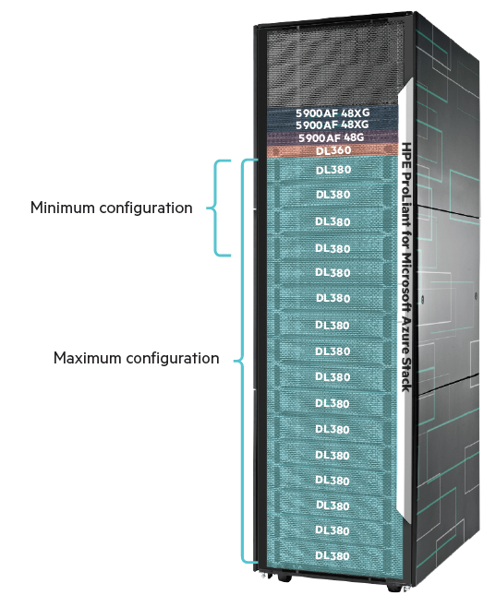
HPE Azure Stack on ProLiant Launch Promotion
From October 1st 2017 to January 31st 2018
Value Proposition
Flexible Hybrid Cloud platform, relevant for multiple uses cases in parallel e.g. secure Dev/Ops, secure Micro-Services, IOT, repatriated Shadow IT workloads, secure Analytics etc
Enables simple, efficient & frictionless hybrid strategy
(for Service Providers) allows the creation of multi tenant Clouds (= Public Cloud) and Community Clouds
Offer *
Choose one of the three pre-configured bundles and benefit up to 65% discount off list price
Targeted audience
EMEA HPE Partners (Resellers and Distributors), Service Providers and End customers
Offer Period
From October 1st 2017 to January 31st 2018
Geographical scope
Check with your Distributor for availability
* Offer Subject to special Terms and Condition
 | Minimum 4-node | Max Efficiency 4-node | Max Efficiency 12-node
DL380 Gen9 | 4-node | 4-node | 12-node
CPU (Broadwell) | E5 -2650 v4 | E5 -2699 v4 | E5 -2699 v4
Memory | 256GB | 768GB | 768GB
All Flash SSD / node | 10x6TB HDD + 4x1.92TB SSD
SW license | incl.: OneView, iLO, WS16 license*
Installation & Start up | HW Installation; SW on-site deployment (via Consulting)
Support | 3Y Proactive Next Business Day
Other key components | ToR switches, DL360 Management server, accessories
*Microsoft Azure Stack SW license based on the consumption model is not included
*Microsoft Azure Stack SW license based on the consumption model is not included

Slide 21

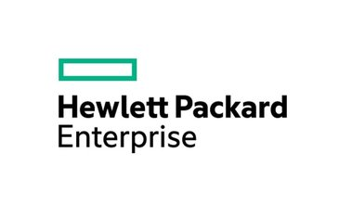
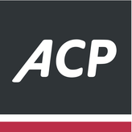


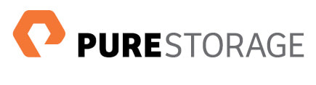
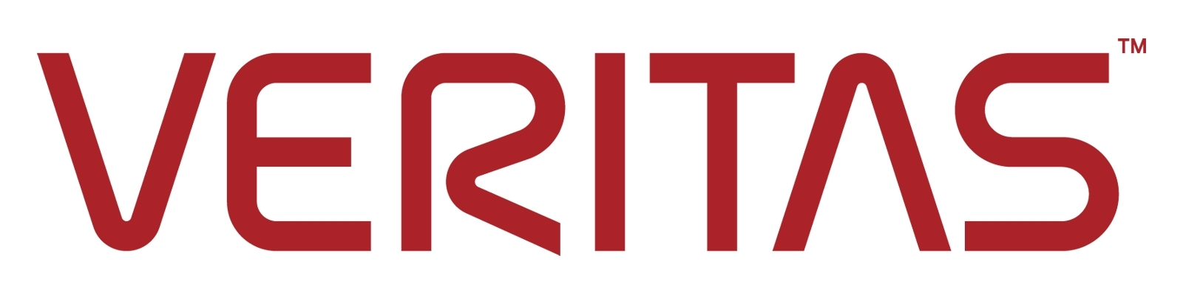






Thanks to our Sponsors!

